Slide 1

Masterclass
16:00 |  | Opening Huishuidelijke mededelingen
 |  | Theory
 |  | Hands on
18:00 |  | Pizza
 |  | Theory
 |  | Hands on
19:15 |  | Gebouw verlaten!
Unsupervised
analysis
DI-Lab
Rijkswaterstaat | Datalab | MASTERCLASS | E.Taskesen | Okt 2019

Slide 2




MACHINE LEARNING
SUPERVISED
CLASSIFICATION
UNSUPERVISED
clustering
$$y=f(X)$$
$$?=f(X)$$
output / label
input / features
output / label
input / features

Slide 3

Which part of ml exactly?

Slide 4
learnings
Applications
Metrics and linkages
Clustering algorithms
Cluster validation

Slide 5


applications
SENSOR
DATA
SPEECH RECOGNITION
IMAGE RECOGNITION
#
OUTLIER
DETECTION
TOPIC DETECTION
UNDERSTAND/ OPTIMIZE CLASSIFIERS

Slide 6
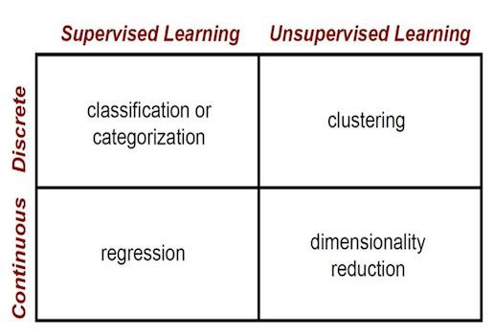
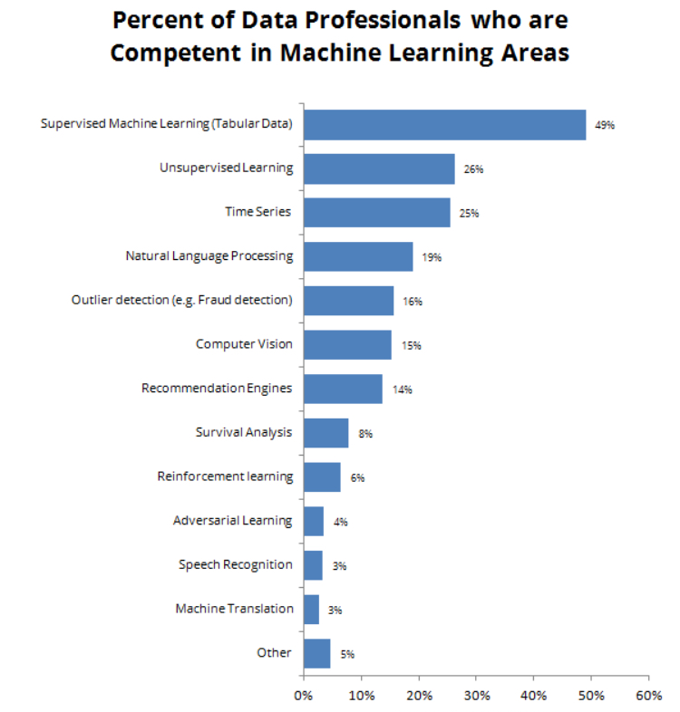
APPLICATIONS IN KAGGLE STATISTICS
Clustering and
Embeddings and
dim.reductions
Clustering and
Embeddings and
dim.reductions

Slide 7
concept
Clustering

Slide 8
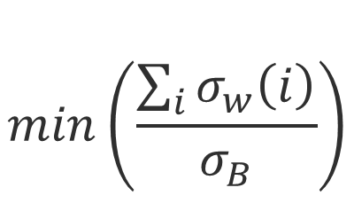
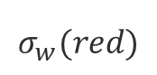
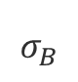
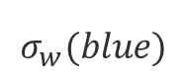
What is a cluster?
SAMPLES WITH SIMILAR PROFILES
WHEN IS THERE STRUCTURE?
Structure if:
1) Samples within the cluster are close to each other
2) Clusters are far apart
$$σ_{B}$$
x
WITHIN VARIANCE
x
$$min\left(\frac{\sum_{i}{σ_{w}\left(i\right)}}{σ_{B}}\right)$$
$$σ_{w}(red)$$
$$σ_{w}(blue)$$
BETWEEN VARIANCE

Slide 9
theory
Metrics and linkages

Slide 10
SIMILARITY BETWEEN SAMPLES
Samples
Metrics
F₁
F₂
Features
F_{N}
Euclidean distance
Pearson correlation
Mixed Pearson correlation
d( , ) d( , )
d( , ) d( , )
d( , ) d( , )
<
≈
≈
d( , ) d( , )
d( , ) d( , )
d( , ) d( , )
<<
<<
≈

Slide 11
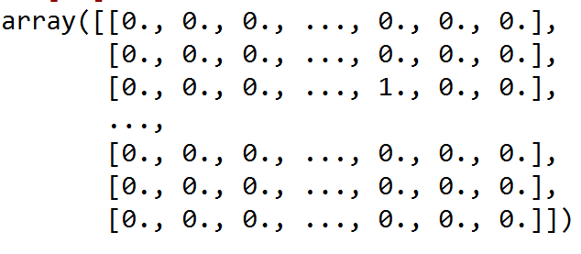
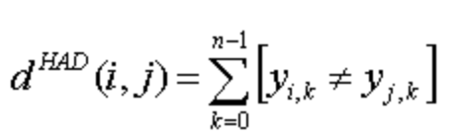




SIMILARITY BETWEEN SAMPLES
Features
1, 2, 3, …, 80
1
Samples
Samples
0
Features
Hamming distance
0
4/8 | 0
5/8 | 1/8 | 0
4/8 | 4/8 | 3/8 | 0
d( , ) d( , )
<<
d( , ) d( , )
<
Dissimilarity matrix (dismat)

Slide 12
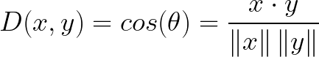
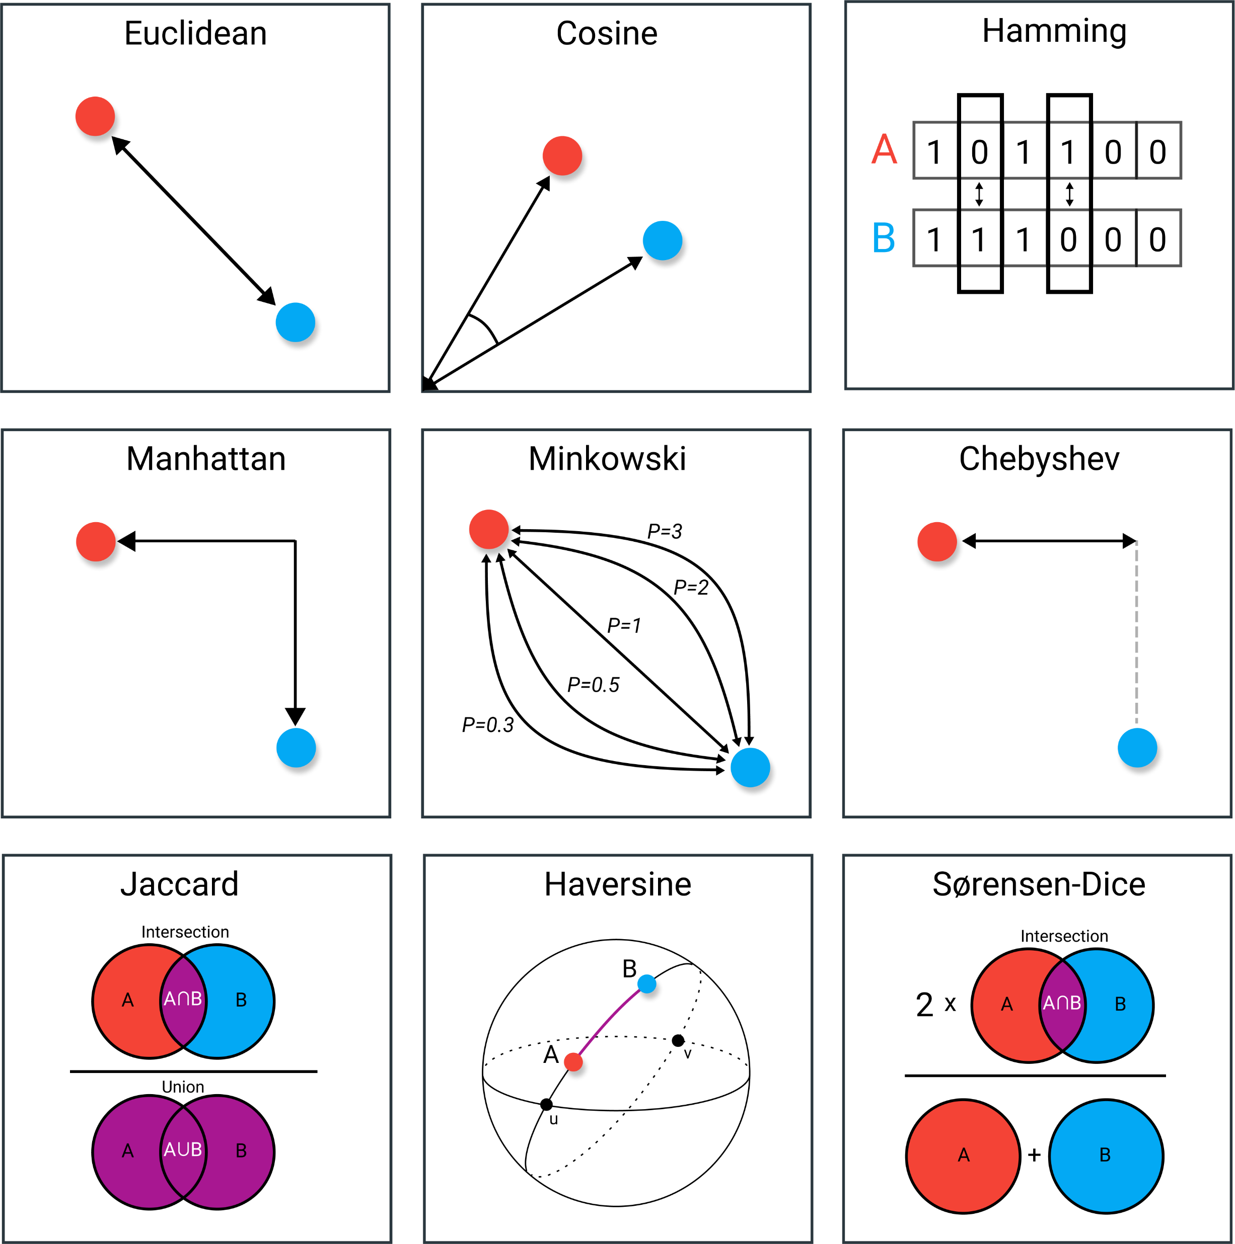
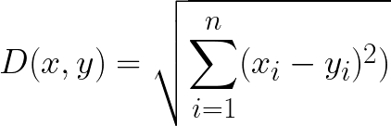
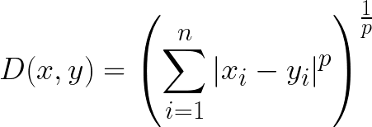
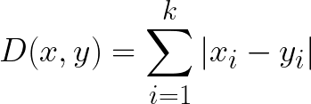
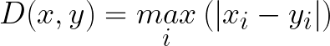
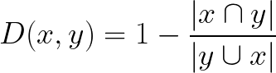
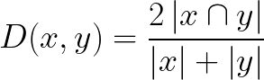
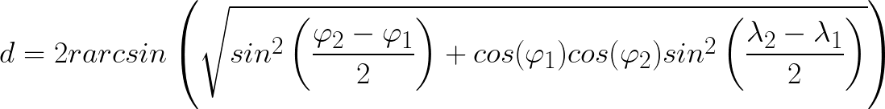
METRICS
Notes:
https://towardsdatascience.com/9-distance-measures-in-data-science-918109d069fa

Slide 13
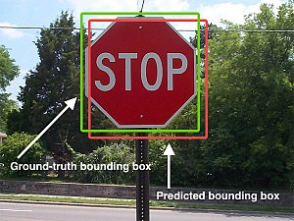

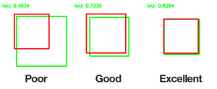
METRICS
Notes:
https://towardsdatascience.com/9-distance-measures-in-data-science-918109d069fa

Slide 14
METRICS
Categorical/
One-Hot data
Notes:
https://towardsdatascience.com/9-distance-measures-in-data-science-918109d069fa

Slide 15
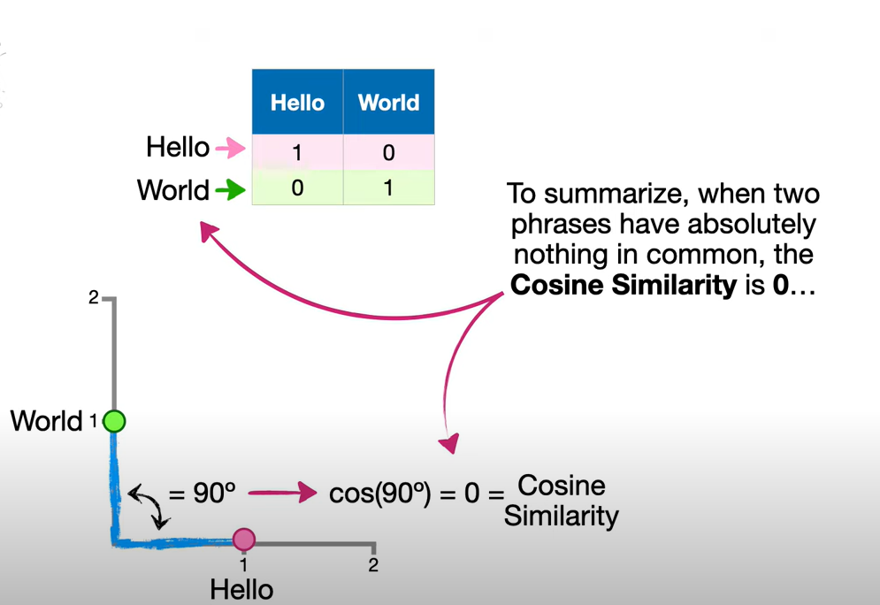
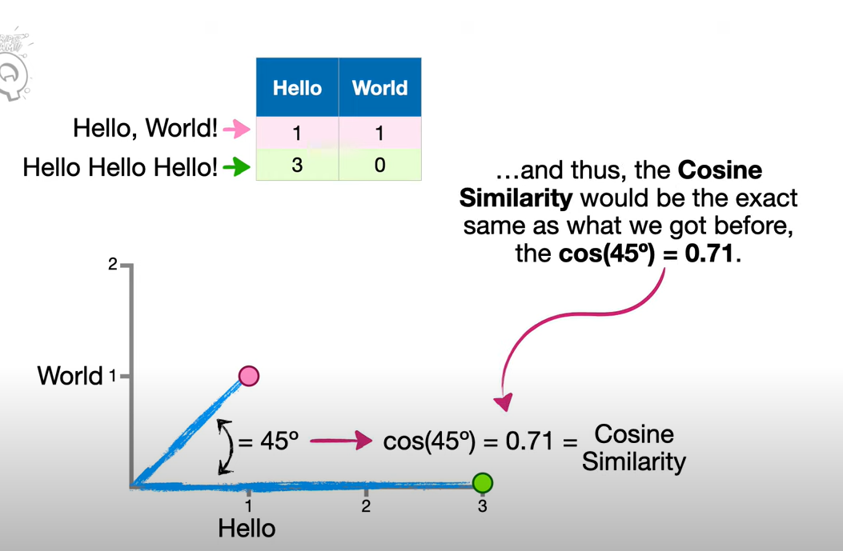
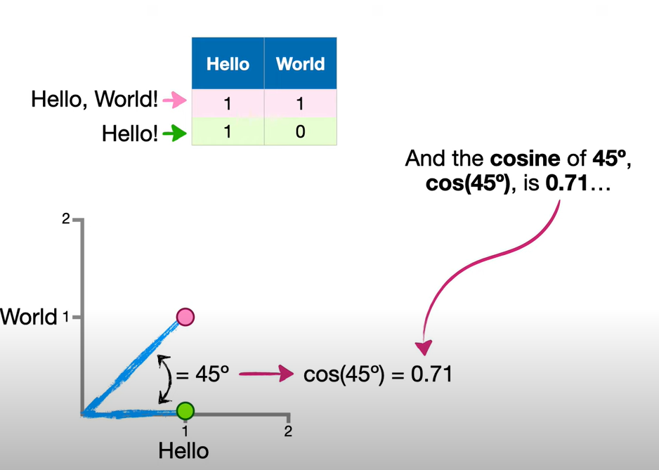
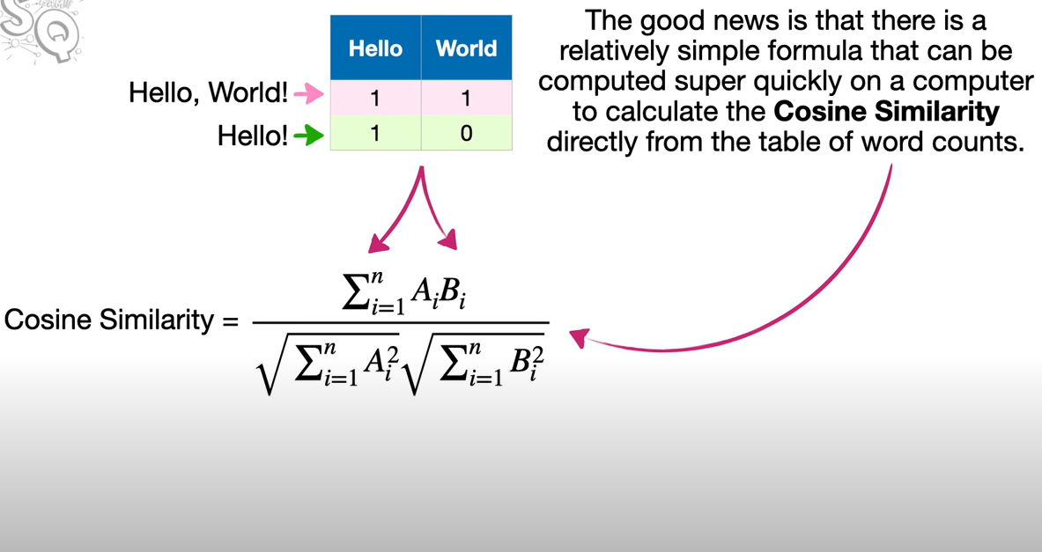
METRICS
Notes:
https://towardsdatascience.com/9-distance-measures-in-data-science-918109d069fa

Slide 16
hierarchical
4
2
3
7
f2
5
8
1
6
Euclidean distance
4
2
3
7
5
8
1
6
f1
Find most similar samples and group

Slide 17
hierarchical
dendrogram
C₁
4
2
3
7
Height = distance between objects
f2
5
8
1
6
4
2
3
7
5
8
1
6
f1
objects 4 and 2
Again, find most similar objects (samples or clusters) and group

Slide 18
hierarchical
dendrogram
C₁
4
2
3
7
C₂
f2
5
8
1
6
4
2
3
7
5
8
1
6
f1
objects 5 and 8
Repeat finding most similar objects (samples or clusters) and grouping them

Slide 19
hierarchical
dendrogram
C₁
4
2
3
7
C₂
f2
5
8
1
6
4
2
3
7
5
8
1
6
f1
Join object 3 and cluster 1
Repeat process

Slide 20
hierarchical
dendrogram
C₁
4
2
3
7
C₂
f2
5
8
1
6
4
2
3
7
5
8
1
6
f1
Join [object 7 and cluster 1] into [cluster 1]
Repeat process

Slide 21
hierarchical
dendrogram
C₁
4
2
3
7
C₂
f2
5
8
1
6
4
2
3
7
5
8
1
6
f1
Join [object 1 and cluster 2] and [cluster 2]
Repeat process

Slide 22
hierarchical
dendrogram
C₁
4
2
3
7
C₂
f2
5
8
1
6
4
2
3
7
5
8
1
6
f1
Join [object 6 and cluster 2] and [cluster 2]
Repeat process

Slide 23
hierarchical
dendrogram
4
2
3
C₁
7
f2
5
8
1
6
4
2
3
7
5
8
1
6
f1
data sorted on similarity
Join [cluster 1 and cluster 2] and [cluster 1]
All in one cluster: FINISHED!

Slide 24
hierarchical
dendrogram
4
2
3
C₁
7
f2
5
8
1
6
4
2
3
7
5
8
1
6
f1
data sorted on similarity
How to identify the clusters?

Slide 25
hierarchical
How to identify the clusters?
dendrogram
4
2
3
C₁
7
f2
5
8
1
6
4
2
3
7
5
8
1
6
f1
data sorted on similarity
Make horizontal cut
The set of unique observations beneath the cut form the clusters

Slide 26
Hierarchical clustering: Similarity between clusters

Slide 27
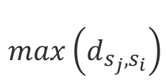
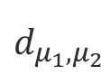
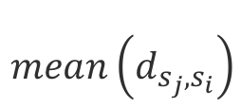
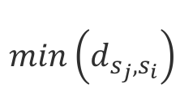
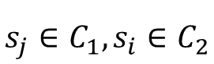
Hierarchical clustering: Similarity between clusters
LINKAGE:
$$s_{j}∈C_{1},s_{i}∈C_{2}$$
COMPLETE: maximum dissimilarity
SINGLE: minimum disimilarity
AVERAGE: mean dissimilarity
CENTROID: dissimilarity of the centroids
$$\max\left(d_{s_{j},s_{i}}\right)$$
SL
$$\min\left(d_{s_{j},s_{i}}\right)$$
AL
$$\operatorname{mean}\left(d_{s_{j},s_{i}}\right)$$
CL
$$d_{μ_{1}, μ_{2}}$$
Single linkage: Closest objects
Complete linkage: Furthest objects
Average linkage: Average dissimilarity

Slide 28
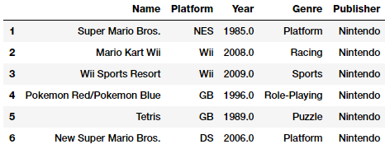
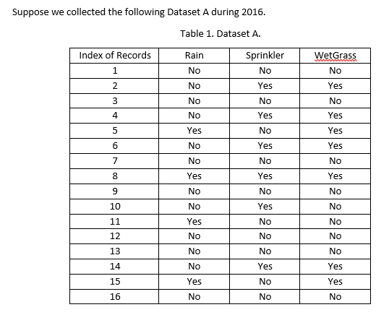
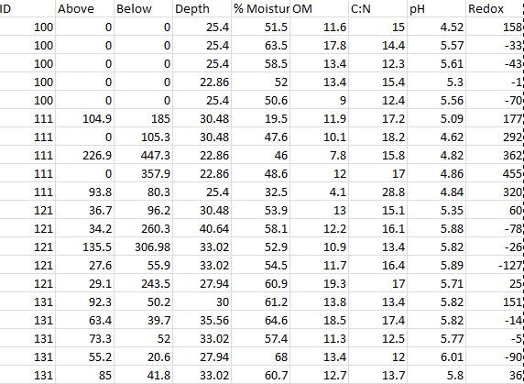
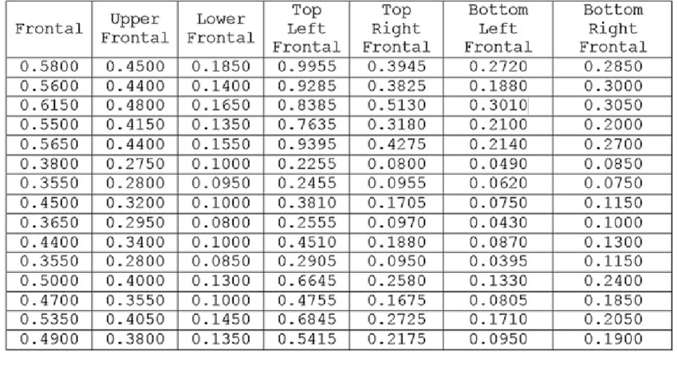
hamming
DATA 1
Hamming
Jaccard is a measure of similarity for the two sets of data, with a range from 0% to 100%. The higher the percentage, the more similar the two populations.
Hands on
DATA 2
Metrics and linkages
Manhattan
Eucledian/corr
Manhattan may be appropriate if different dimensions are not comparable.
DATA 4
DATA 3

Slide 29
theory
Clustering algorithms
Hierarchical clustering (Agglomerative)
Kmeans
DBSCAN

Slide 30
hierarchical
How to identify the clusters?
dendrogram
4
2
3
C₁
7
f2
5
8
1
6
4
2
3
7
5
8
1
6
f1
data sorted on similarity
Make horizontal cut
The set of unique observations beneath the cut form the clusters

Slide 31
Single vs Complete linkage:
Shape influences
Suppose we have the
following 4 clusters.
What happens if we use:
Single linkage
Complete linkage
complete linkage ?
single linkage ?
Notes:
Suppose we have those 4 clusters, how will different linkages affect the grouping?

Slide 32
Single vs Complete linkage:
Shape influences
Shortest complete linkage distance
complete linkage ?
single linkage ?

Slide 33
Single vs Complete linkage:
Shape influences
Shortest single linkage distance
complete linkage ?
single linkage ?

Slide 34
Single vs Complete linkage:
Shape influences
complete linkage
single linkage

Slide 35
Single vs Complete linkage:
Shape influences
complete linkage
single linkage

Slide 36
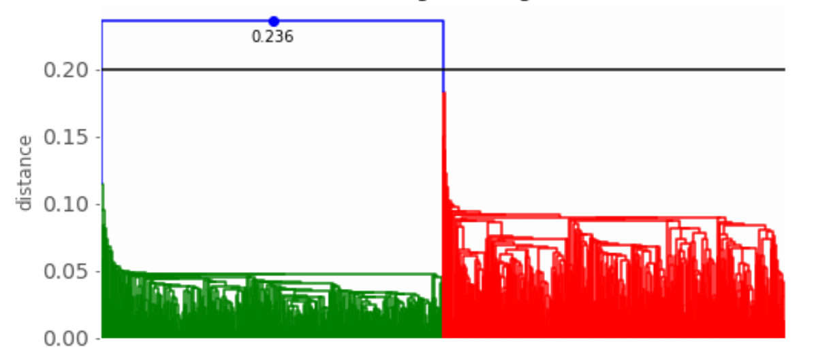
Single vs Complete linkage:
Shape influences
single linkage
complete linkage?
single linkage?
notebook exercise

Slide 37
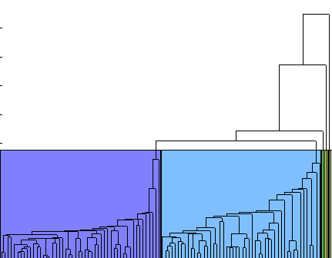
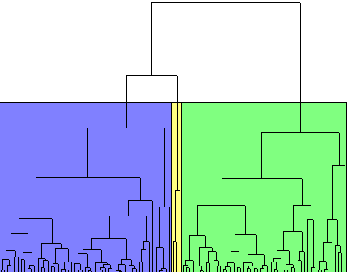
Single vs Complete linkage:
Shape influences
Single
Complete
notebook exercise

Slide 38
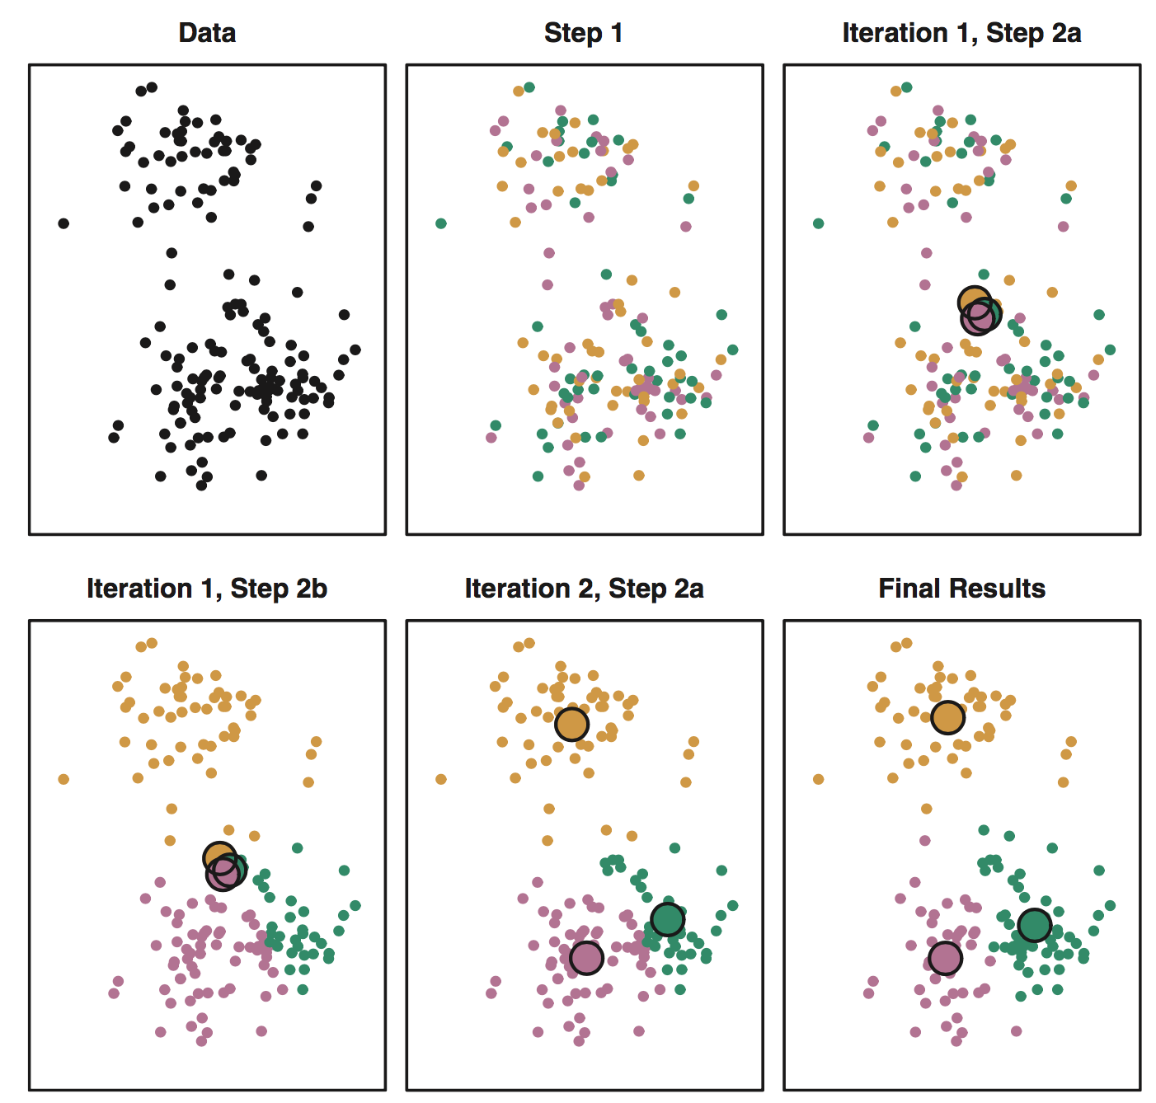
K-means clustering
Choose k clusters (=centroids/prototypes)
Randomly assign samples to prototypes
Until cluster centroids stop changing
For each cluster, compute the centorid (=mean feature vector of all samples)
Assign each observation to the cluster whose centroid is closest.
Partitions a data set into K distinct, non-overlapping clusters

Slide 39
K-means clustering
K=2
Metric:
Euclidean
Randomly drop prototypes in search space

Slide 40
K-means clustering
K=2
Metric:
Euclidean
Assign objects to closest prototype
Blue area: cluster 1
White area: cluster 2

Slide 41
K-means clustering
K=2
Metric: Euclidean
Calculate new cluster prototypes
By averaging objects

Slide 42
K-means clustering
K=2
Metric: Euclidean
Re-assign objects to closest prototype
Blue area: cluster 1
White area: cluster 2

Slide 43
K-means clustering
K=2
Metric: Euclidean
Re-calculate new cluster prototypes

Slide 44
K-means clustering
K=2
Metric: Euclidean
Re-assign objects to closest prototype
If no objects change cluster then finished

Slide 45
K-means clustering
Metric: Euclidean
Establish clusters

Slide 46
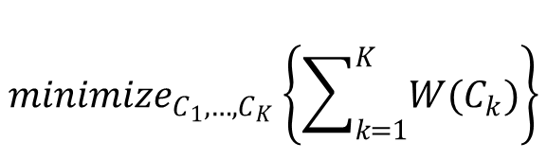
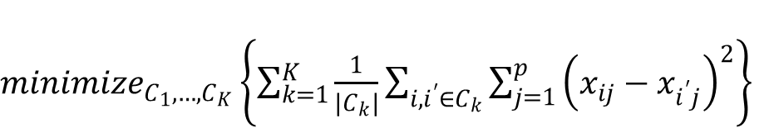
K-means clustering
Each prototype is assigned to one single cluster.
Good clustering = within-cluster variation (=INERTIA) is as small as possible.
$${minimize}_{C_{1},…, C_{K}}\left\{\sum_{k=1}^{K}{W(C_{k})}\right\}$$
${minimize}_{C_{1},…, C_{K}}\left\{\sum_{k=1}^{K}{\frac{1}{|C_{k}|}\sum_{i,i^{′}∈C_{k}}{\sum_{j=1}^{p}{{\left(x_{ij}−x_{i^{′}j}\right)}^{2}}}}\right\}$
The lower the better
Normalize for the number of clusters
For each sample to centroid
Sum over each cluster
INERTIA= The sum of squared error for each cluster.
The smaller the inertia the denser the cluster
Thus the closer together all the points are
Partitions a data set into K distinct, non-overlapping clusters

Slide 47
K-means clustering
Advantages:
Easy to use
Low computational costs: fast!
Disadvantages:
Euclidean distance is used as a metric
Variance is used as a measure of cluster scatter
an inappropriate choice of k may yield poor results
Random initialization prototypes may lead to different results
Key limitation
Model aims to detect spherical clusters, such that mean value converges towards the cluster center.
The clusters are expected to be of similar size.

Slide 48
Dbscan: Density-based spatial clustering of applications with noise
D=All points that are within a distance
Algorithm input:
Set of points
Distance N
min_samples (density)
D
Output:
Each cluster is a high density region
in the search space
Each point is now labelled as:
Core point
Border point
Noise point
Notes:
Set of points to be clustered
Neighborhod N is used to set the cut-off for similarity
Min points parameters that defines the value at which a neighborhood of points is considered dense.

Slide 49
Dbscan
D=All points that are within a distance
Algorithm input:
Set of points
Distance N
min_samples (density)
Min_samples=4
4<6
D
Output:
Each cluster is a high density region
in the search space
Each point is now labelled as:
Core point has at least min_samples in his neighbourhood
Border point
Noise point
Notes:
Set of points to be clustered
Neighborhod N is used to set the cut-off for similarity
Min points parameters that defines the value at which a neighborhood of points is considered dense.

Slide 50
Dbscan
Algorithm input:
Set of points
Distance N
min_samples (density)
Noise
Min_samples=4
4<6
D
Output:
Each cluster is a high density region
in the search space
Each point is now labelled as:
Core point has at least minpts in his neighbourhood
Border point is a non-core point but with at least one core in neighbourhood
Noise point represents outlier (not core and not border and does not belong to any group)
Notes:
Set of points to be clustered
Neighborhod N is used to set the cut-off for similarity
Min points parameters that defines the value at which a neighborhood of points is considered dense.
DBSCAN assigns each core and border point to a cluster

Slide 51
Dbscan
Starts with unassigned core point
Performs depth-first search at that point
Notes:
Set of points to be clustered
Neighborhod N is used to set the cut-off for similarity
Min points parameters that defines the value at which a neighborhood of points is considered dense.
DBSCAN assigns each core and border point to a cluster

Slide 52
Dbscan
Starts with unassigned core point
Performs depth-first search at that point
Notes:
Set of points to be clustered
Neighborhod N is used to set the cut-off for similarity
Min points parameters that defines the value at which a neighborhood of points is considered dense.
DBSCAN assigns each core and border point to a cluster

Slide 53
Dbscan
Advantages:
Any number of lcusters
Can find clusters of varying size and shape
Ignore outliers
Disadvantages:
Sensitive to choice of parameters
Distance to small will make sparse clusters
Distance to large will make one big cluster

Slide 54
Subjectivity in clustering
Principle choices:
similarity between samples (metric)
similarity between clusters (linkage)
algorithm
Different choice leads to different results
Subjectivity becomes reality
Cluster process
Validate, interpret (generate hypothesis), repeat steps

Slide 55
Hands on
Clustering algorithms

Slide 56
theory
Clustering validation

Slide 57
Cluster validation
Determine the optimal cut for the clustering
Davies Bouldin index (DB-index)
Silhoutte score
Within cluster sum of squares
1
2
3
score
4
5
6
8
7
2
3
4
5
6
7
8
1
2
3
4
5
6
7
8
Cluster k
Cluster data
Cut (tree) at (all) levels or for different k (kmeans)
Evaluate the clusters

Slide 58
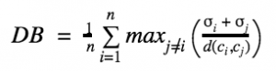
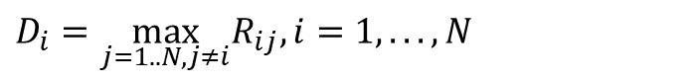
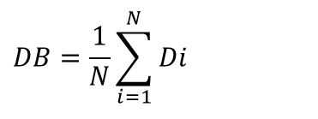
Davies-Bouldin index
Captures the intuition that clusters that are (1) well-spaced from each other and (2) themselves very dense
Similarity cluster C_{i} and C_{j}
Smaller is better
=
Towards 0 is best
Larger is better
σ_{w}(i)
Most similar cluster to C_{i}
‘max’ statement repeatedly selects the values where the average point is farthest away from its centroid, and where the centroids are closest together.
$$D_{i}=\max_{j=1..N,j≠i}R_{ij},i=1,...,N$$
DB index
$$DB=\frac{1}{N}\sum_{i=1}^{N}{Di}$$
Where n is number of clusters,
σi is the average distance of all points in cluster i from the cluster centroid ci.
Towards 0 is best
Notes:
The DB index captures the intuition that clusters that are (1) well-spaced from each other and (2) themselves very dense are likely a ‘good’ clustering. This is because the measure’s ‘max’ statement repeatedly selects the values where the average point is farthest away from its centroid, and where the centroids are closest together.

Slide 59
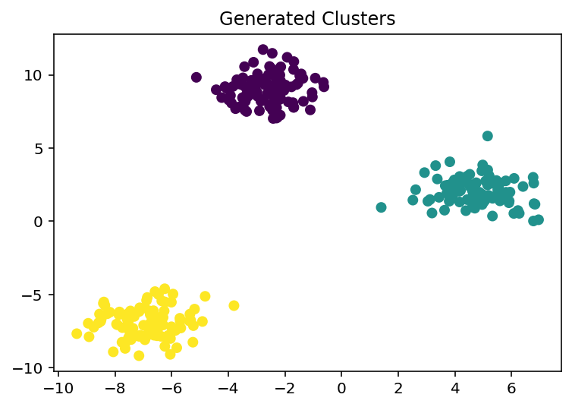
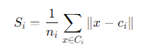
Davies-Bouldin index (1: Tightness)
Step 1: Find the tightness of each cluster (within-cluster scatter Si)
If points are really close, the group is tight and well-organized.
Mathematically: The average distance between points in the same cluster
For each cluster, Si is computed. A smaller Si value means that points are closer, so it's a tight group.
ni: Number of points in cluster I
Ci: All points in clusters in i
ci: The mean of the cluster i
x: datapoint in the cluster
Cluster 0 - S0: 1.190
Cluster 1 - S1: 1.199
Cluster 2 - S2: 1.271

Slide 60
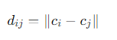
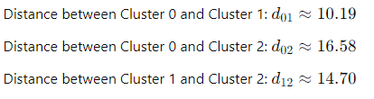
Davies-Bouldin index (2: separation)
Step 2: Measure how far different clusters are from each other.
Inter-cluster distance: Di,j
Mathematically: The distance between cluster i and j is:
array([[ 0. , 10.19470965, 16.58162892],
[10.19470965, 0. , 14.70312974],
[16.58162892, 14.70312974, 0. ]])

Slide 61
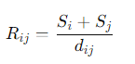
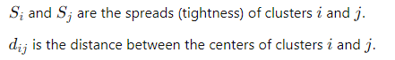
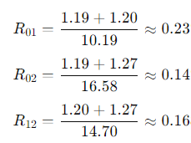
Davies-Bouldin index (3: ratio)
Step 3: Compute Ratio tightness vs. separation
This tells us if two clusters are overlapping or separate.
A small value means the clusters are far apart relative to how spread out they are (good separation).
Mathematically:
array([[0. , 0.23443123, 0.14849351],
[0.23443123, 0. , 0.16808553],
[0.14849351, 0.16808553, 0. ]])
Rij=

Slide 62
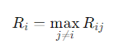
Davies-Bouldin index (4: penalty)
Step 4: The penalty for bad clusters
This tells us how badly clusters are separated from each other.
Mathematically:
array([[0. , 0.23443123, 0.14849351],
[0.23443123, 0. , 0.16808553],
[0.14849351, 0.16808553, 0. ]])
Rij=
Ri=[0.23443123, 0.23443123, 0.16808553]
We want this number to be as small as possible.

Slide 63
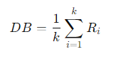

Davies-Bouldin index (5: fin)
Step 5: Compute final score
This is the overall "badness" of the clustering.
A lower Davies-Bouldin Index means that clusters are tight and far apart. This is wat we want!
Mathematically:

Slide 64

Davies-Bouldin index (5: fin)
DB: 0.6183

Slide 65

Davies-Bouldin index (5: fin)
DBindex is dus een cluster score!
Silhouette scores how individual datapoints fit into their own cluster vs the others.
DB: 1.0112
When clusters have very different densities, both metrics might indicate worse performance, but the DB Index will highlight differences in tightness more directly, while the Silhouette Score does it on a per-point basis.

Slide 66
Hands-on
Doe dit ook voor Silhouette in groepjes van 3
Max 15minuten

Slide 67




SILHOUETTE SCORE
Intuition: Samples in the same cluster are closer to each other than to the samples of other clusters
Expensive; complexity of O(n²)
$$s_{C_{1}}=\frac{1}{n_{1}}\sum_{i=1}^{n_{1}}{s_{i}}$$
$$a_{i}=\frac{1}{n_{1}}\sum_{j=1}^{n_{1}}{d_{i,j},} i,j∈C_{1}$$
$$b_{i}=\frac{1}{n_{2}}\sum_{j=1}^{n_{2}}{d_{i,j},} i∈C_{1}, j∈C_{2}$$
$$s_{i}= \frac{b_{i}−a_{i}}{max⁡(b_{i},a_{i})}$$
where a(i) is the average distance of point i from all other points in its cluster and b(i) is the smallest average distance of i to all points in any other cluster.
To clarify, b(i) is found by measuring the average distance of i from every point in cluster A, the average distance of i from every point in cluster B, and taking the smallest resulting value.
S Range [-1, 0, 1]
~0 Inflection point between two clusters
~-1 Better off assigning it to the other cluster
~+1 Belonging to an ‘appropriate’ cluster
High S = better defined clusters

Slide 68


INERTIA OR WITHIN-CLUSTER SUM OF SQUARES
Samples in the same cluster are similar to each other
Inertia of a cluster $C_{k}$ with $n_{k}$ samples and centroid $μ_{k}$:
$$W\left(C_{k}\right)= \sum_{i=1}^{n_{k}}{{\left|\left|x_{i}−μ_{k}\right|\right|}^{2}}$$
Does not take the dissimilarity to samples from other clusters into account.

Slide 69




Comparison evaluation approaches
[data, labels_true] = make_blobs(n_samples=750, centers=5, n_features=10)
DB-index
Silhoutte score
Elbow method

Slide 70

dbscan

Slide 71
Clustering: final remarks
Advantage: You will always find clusters
Disadvantage: You will always find clusters
Do not randomly perform clustering with different parameters. Think before act!
Find something “old”, and something “new” within the domain is a good sign
Make sure, your metric complies with triangularity
Usefull links:
https://distill.pub/2016/misread-tsne/

Slide 72
Masterclass
Unsupervised
analysis
Take home message:
Always visualize your data first,
before you start to train predictors on the data!

Slide 73
Hands on
Clustering
1. Basics : https://colab.research.google.com/github/erdogant/clusteval/blob/master/notebooks/clusteval.ipynb
2. Mixed datasets: https://colab.research.google.com/github/erdogant/clusteval/blob/master/notebooks/clusteval_salary_dataset.ipynb
3. Images : https://colab.research.google.com/github/erdogant/clustimage/blob/master/notebooks/clustimage.ipynb
4. Traffic signs : https://colab.research.google.com/github/rwsdatalab/verkeersborden/blob/master/notebooks/Verkeersborden_clusteren.ipynb

